Slide 1

ECOFASHION MANAGEMENT SYSTEM
GROUP NUMBER - 4
Arpitha Sheshadri Bhat
Vishnu Paduchuri
Ashwini Nagathan
Jahnavi Akkaladevi
Prashanth Talwar
DAMG6210 - DATA MANAGEMENT AND DATABASE DESIGN

Slide 2


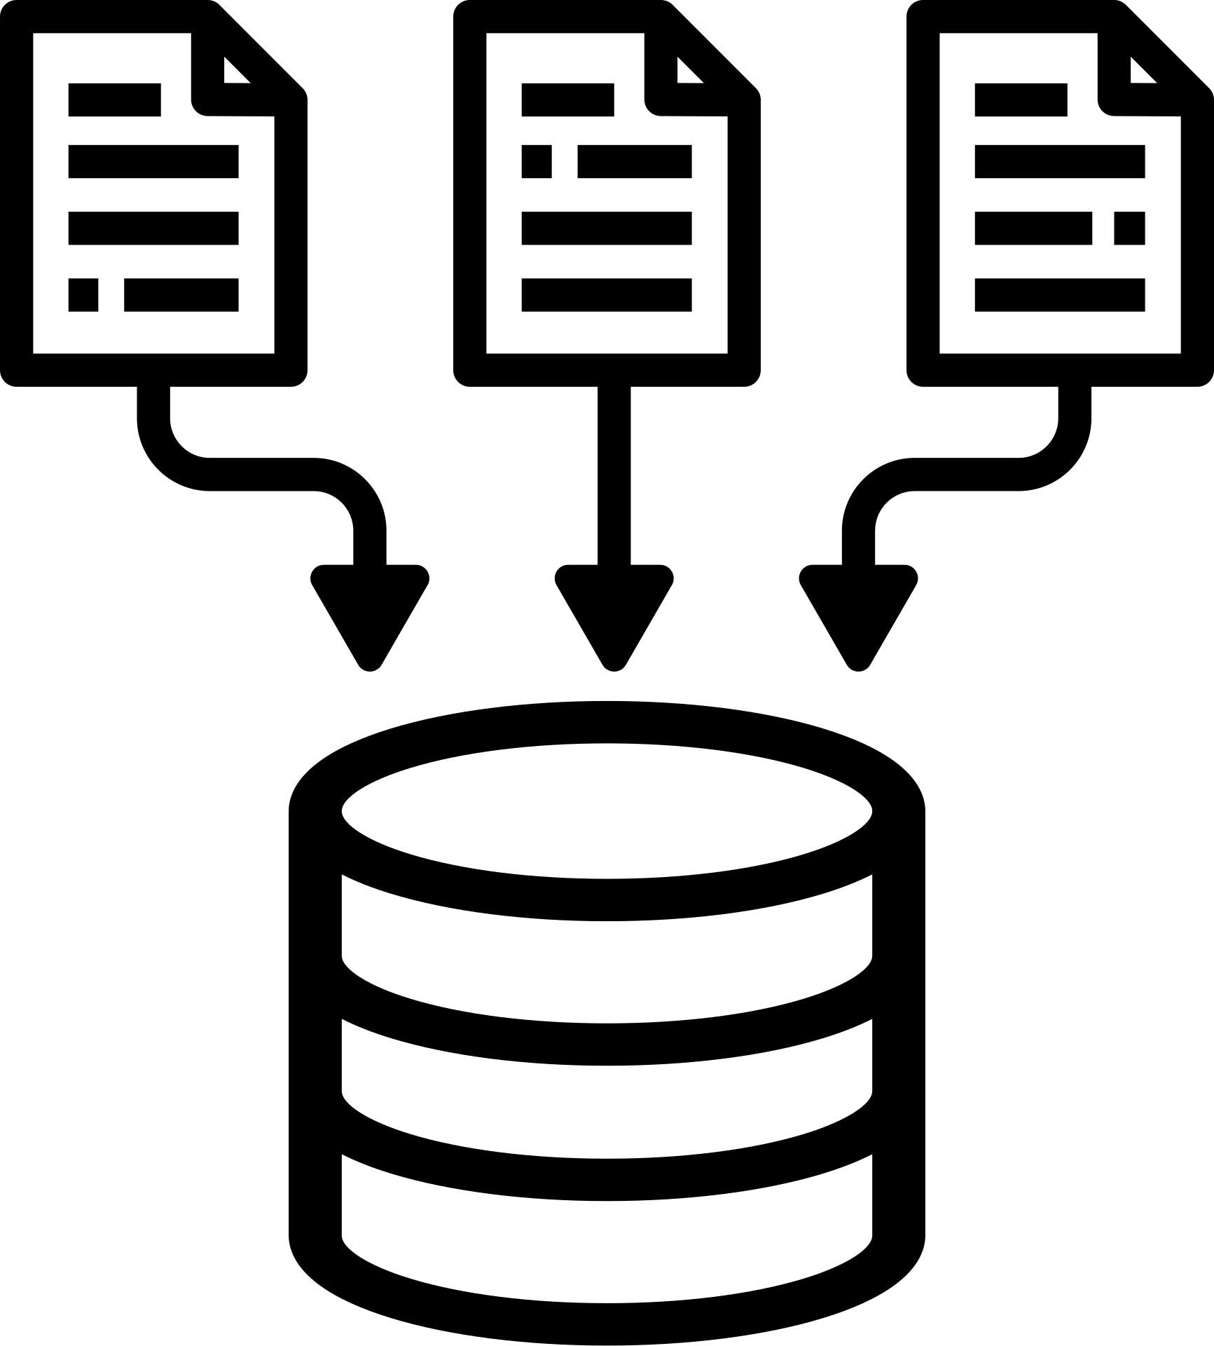

PROJECT OBJECTIVES
INVENTORY
MANAGEMENT
SECURE
DATA STORAGE
VISUALIZATION
SCALABILITY
accuracy and
effectiveness of stock
level updates, product labeling, new item
additions
capitalize and
commercialize on market trends -product analysis, geographical impact, consumer trends. etc
ensuring peak speed and responsiveness with
increased product data
and user interactions
strong security measures
to protect sensitive user
data. Leverage
encryption to store
sensitive data
DAMG6210 - DATA MANAGEMENT AND DATABASE DESIGN

Slide 3
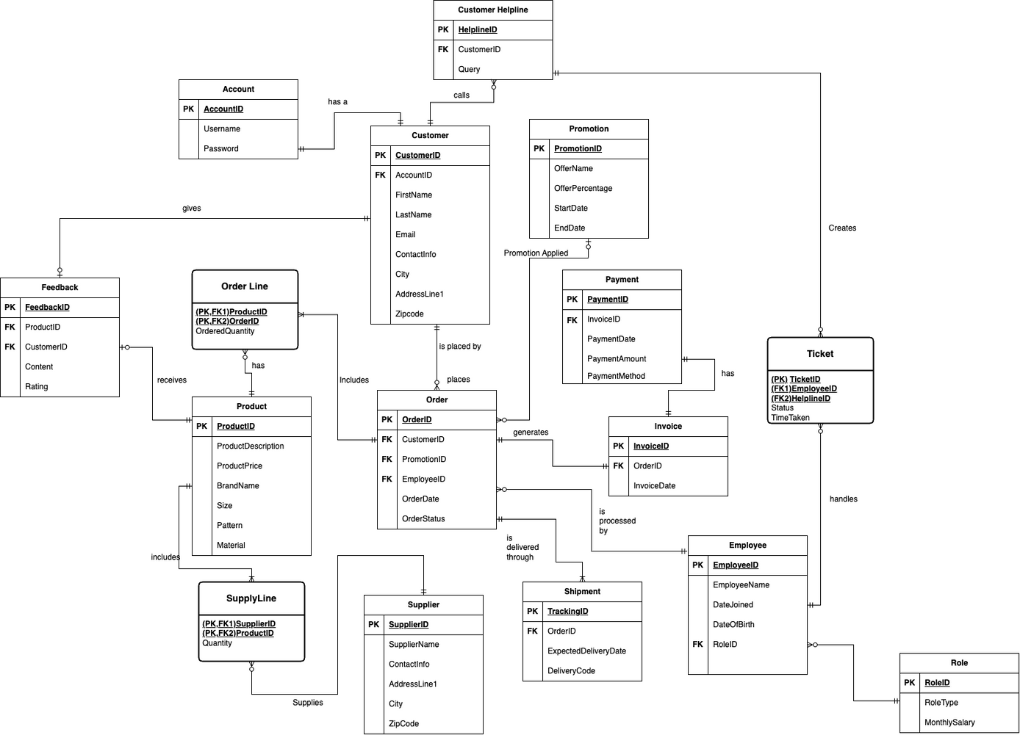
ENTITY RELATIONSHIP DIAGRAM (ERD)
DAMG6210 - DATA MANAGEMENT AND DATABASE DESIGN

Slide 4
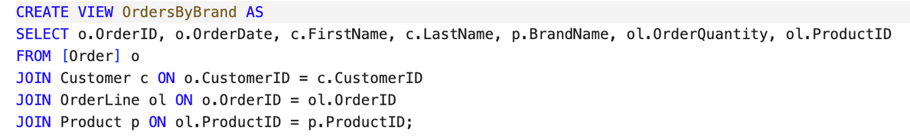
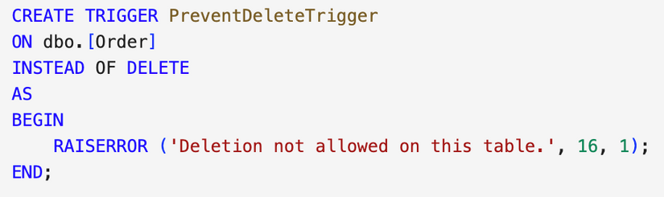
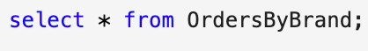
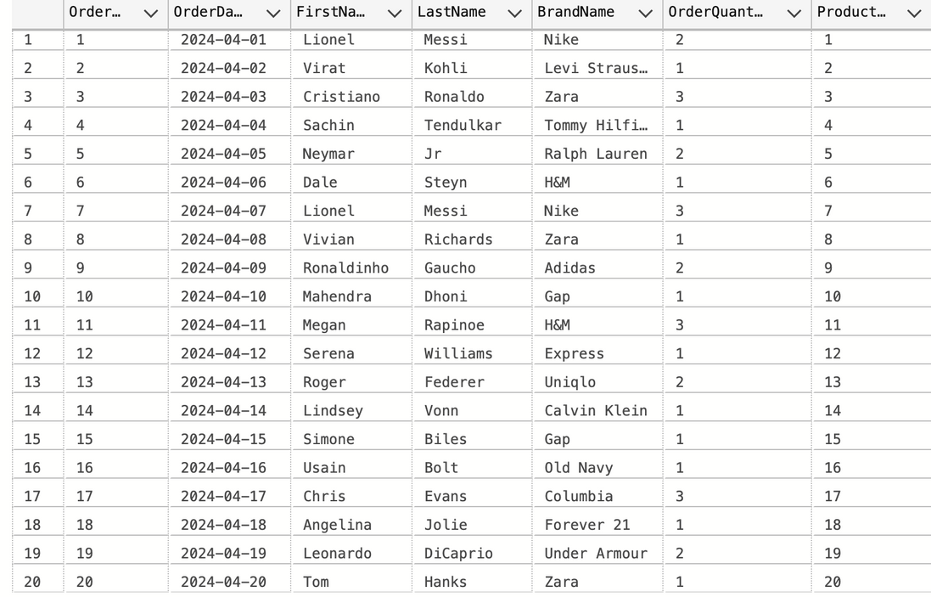
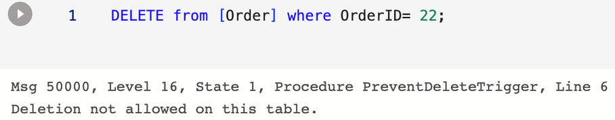
VIEWS
TRIGGERS
OrdersByBrand -
A summarized view that takes data from Order, Customer, Orderline and Product to display an overview of all the orders received in terms of Brand
PreventDeleteTrigger -
An INSTEAD OF trigger that returns an error in case of deletions in the Order Table
Output
Output
DAMG6210 - DATA MANAGEMENT AND DATABASE DESIGN

Slide 5
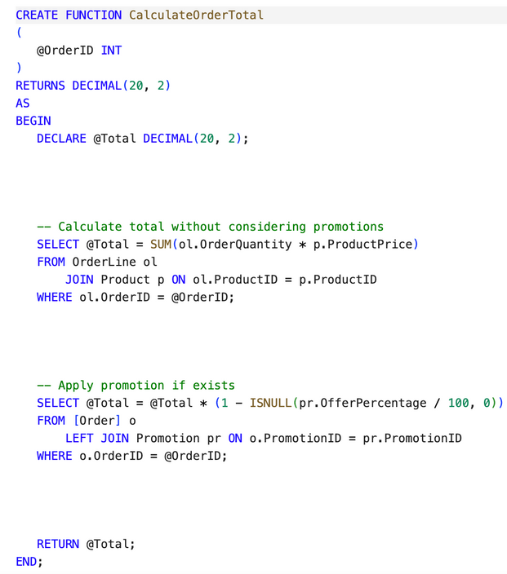
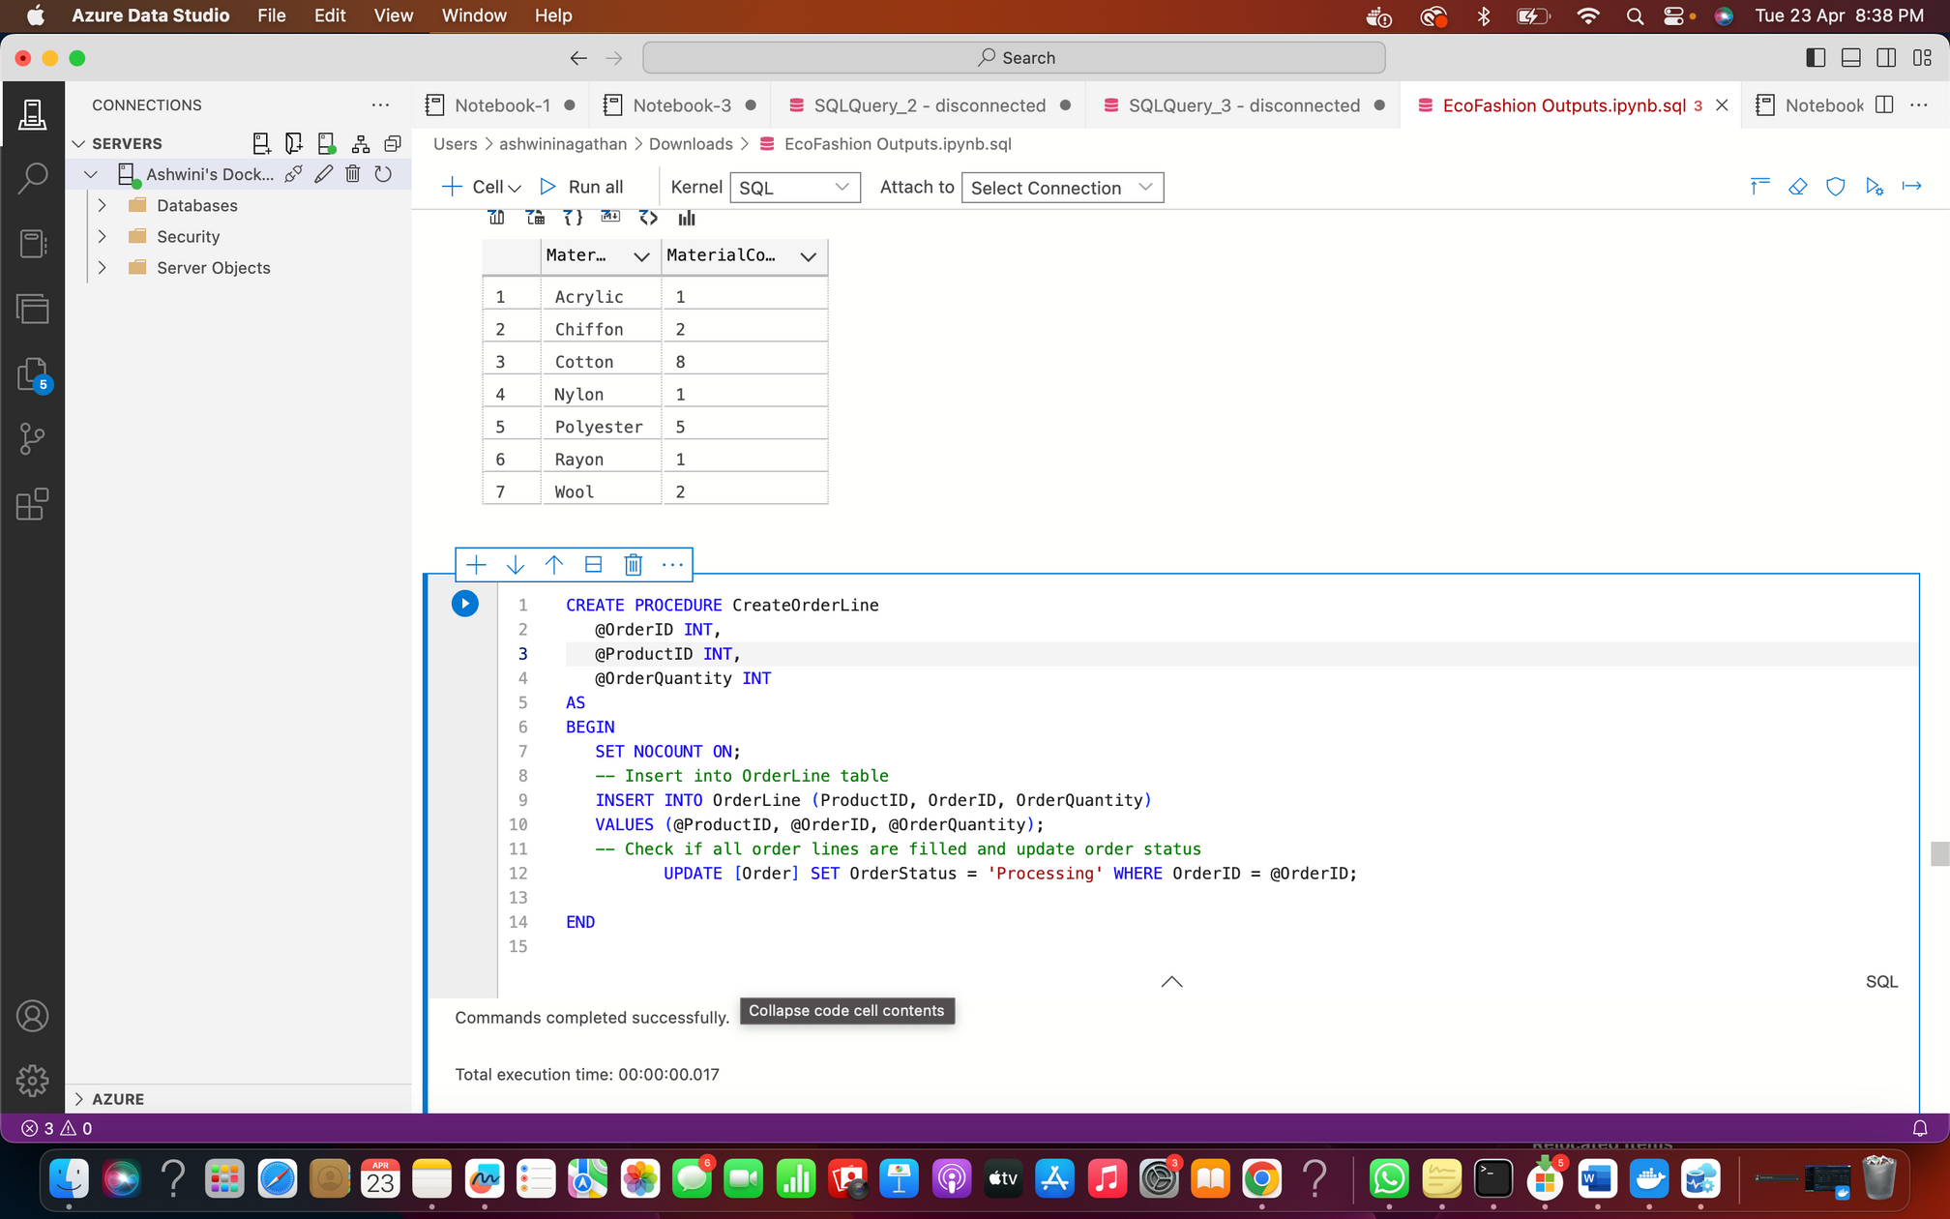
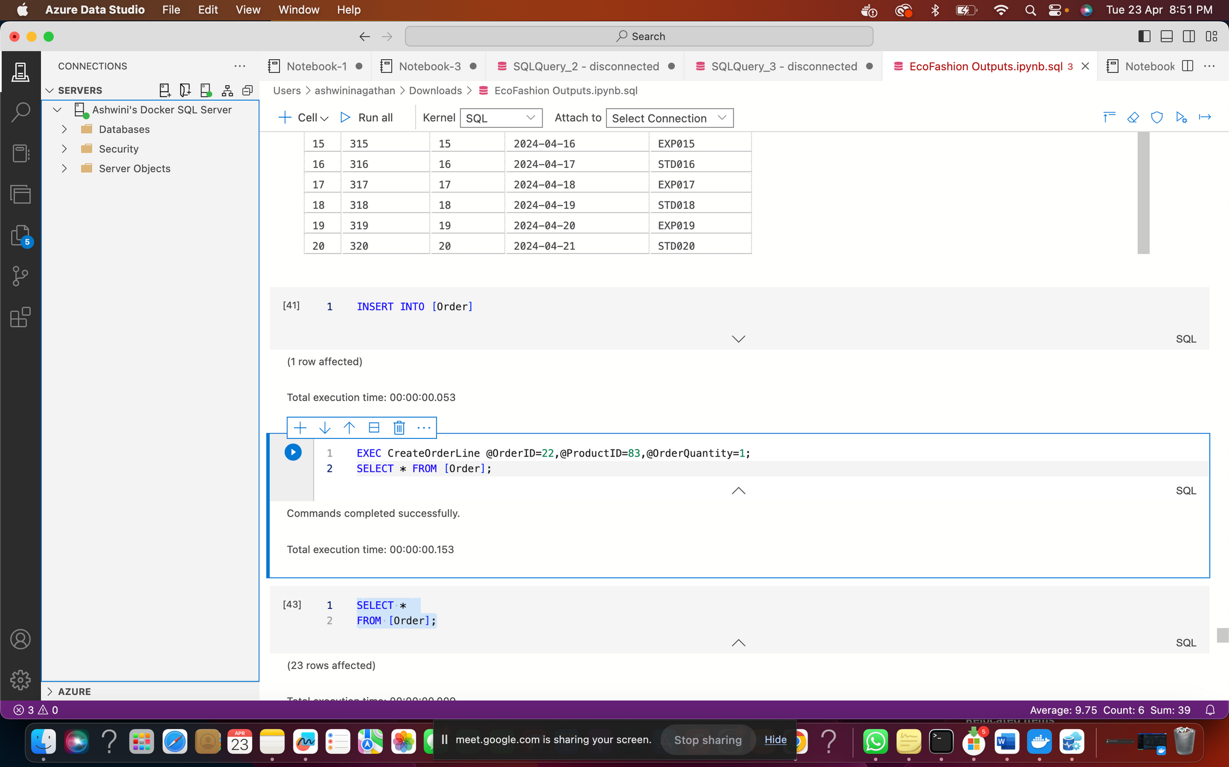
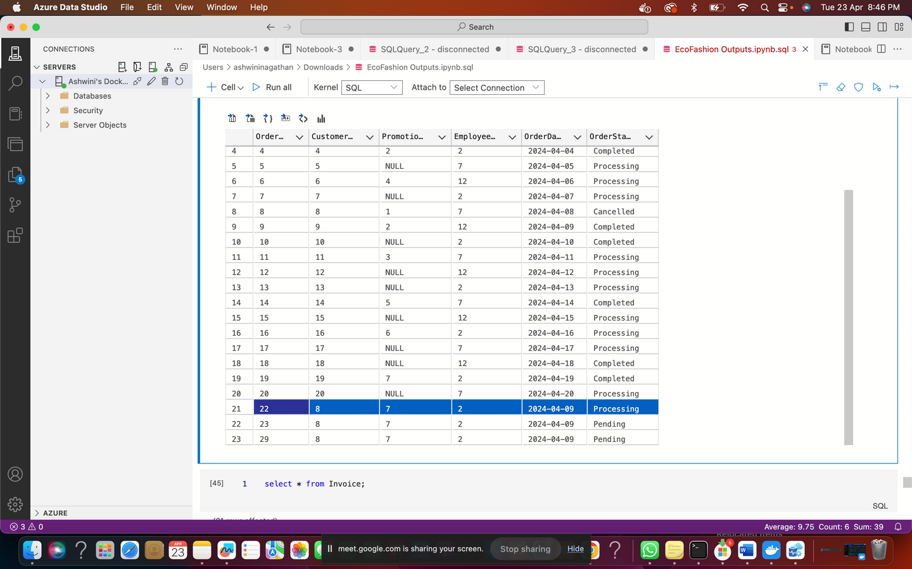
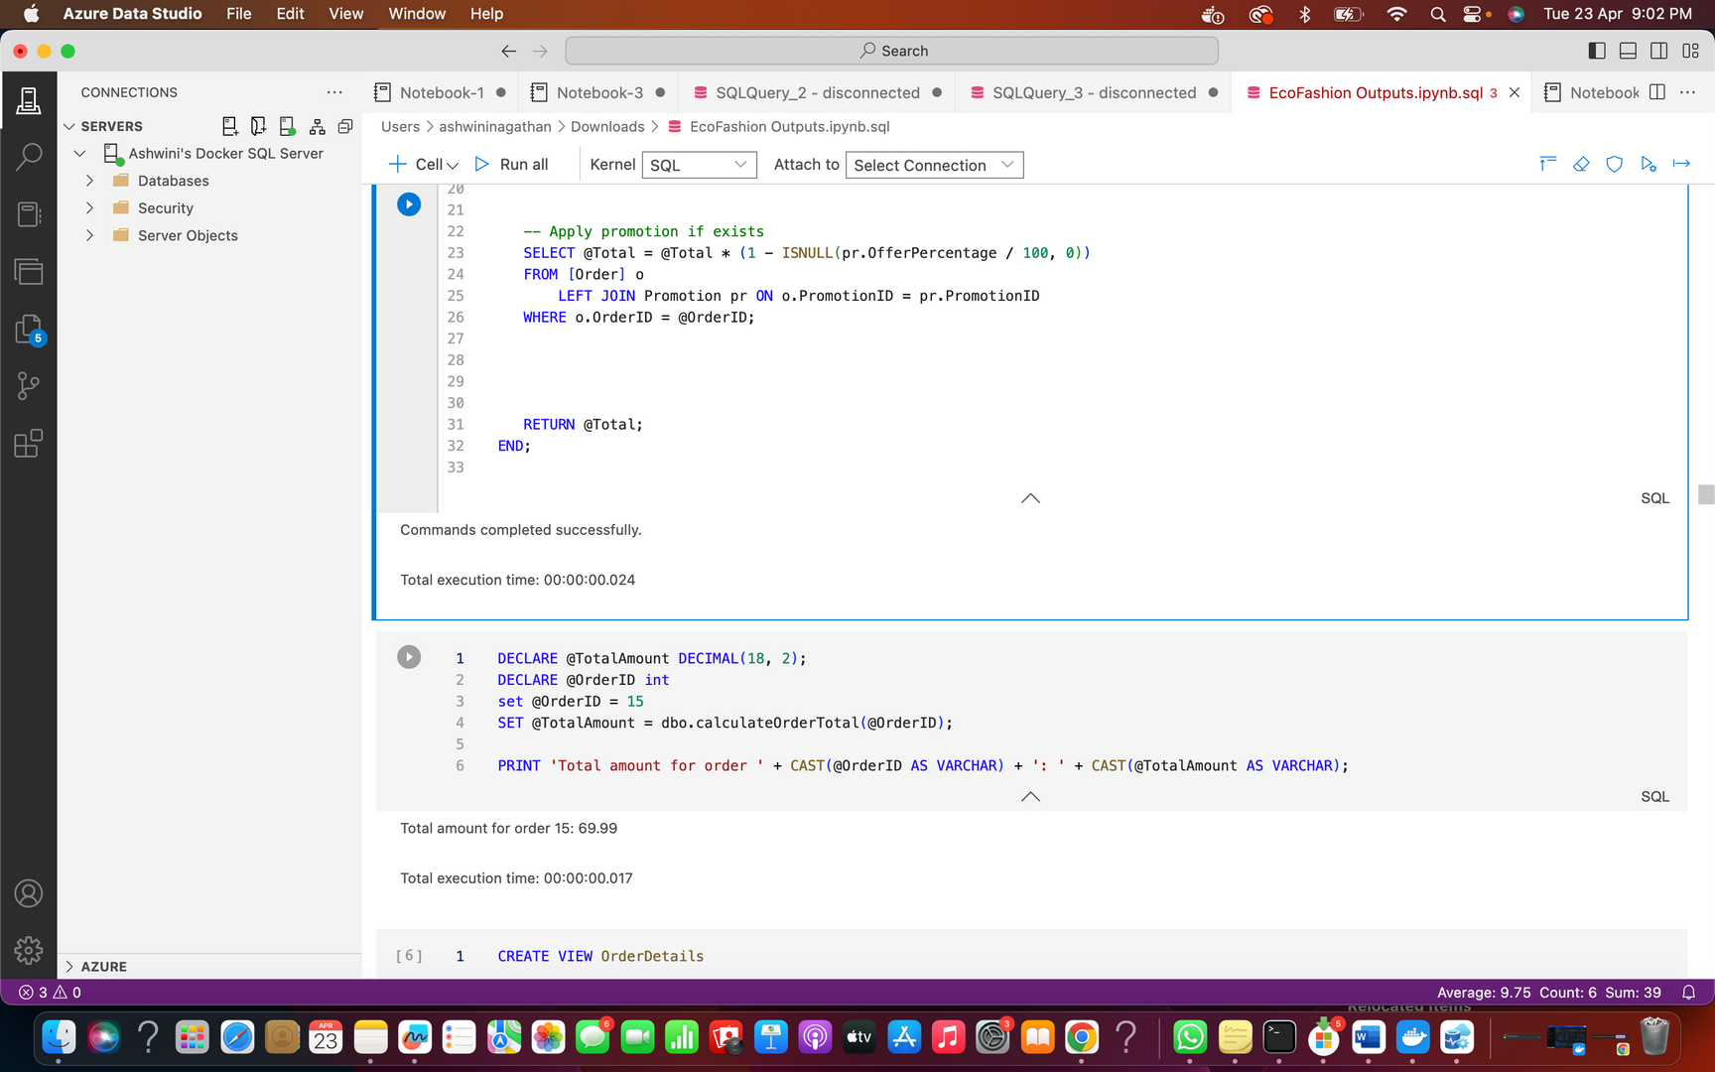
STORED PROCEDURES
USER DEFINED FUNCTIONS
OrdersByBrand -
A procedure to insert data into orderline table and change the order status to ‘processing’ once an order is received.
Input Parameters: @orderID, @productID, @orderedquantity
CalculateOrderTotal -
A function that returns the total of an order (after promotion is applied, if any)
input parameters: @orderID
Output
Output
DAMG6210 - DATA MANAGEMENT AND DATABASE DESIGN

Slide 6
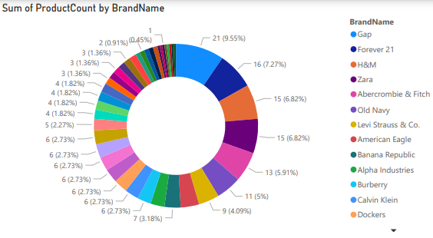
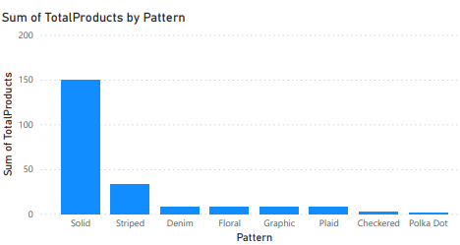
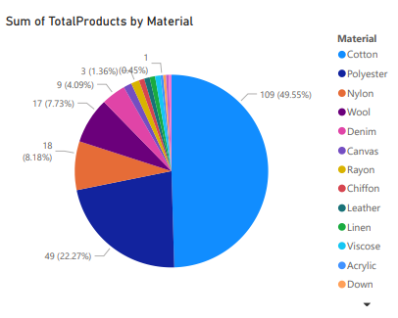
POWER BI REPORT
The Following PowerBI graph represents the following:
1) Total Products by Brand: Measures the number of products each brand offers, highlighting brand presence in the market.
2) Total Products by Pattern: Aggregates products by pattern to analyze consumer preferences and guide inventory decisions.
3) Total Products by Material: Summarizes products by material type (e.g., cotton, polyester, leather), key for tracking manufacturing trends.
DAMG6210 - DATA MANAGEMENT AND DATABASE DESIGN

Slide 7
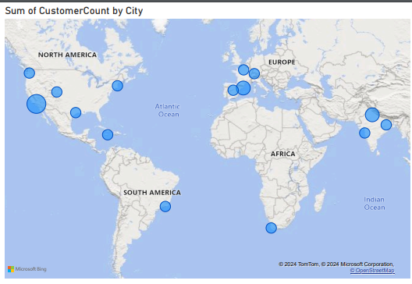
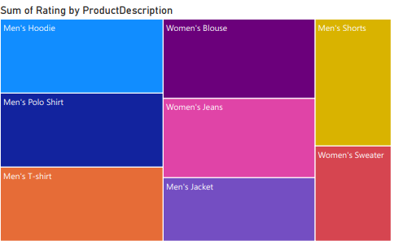
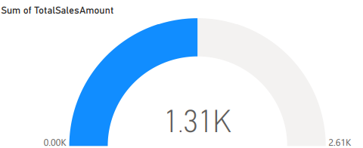
POWER BI REPORT
1) Customer Count by City: Tracks the number of customers per city, showing market penetration and geographic trends.
2) Sum of Rating by Product: Compiles customer ratings for each product, indicating quality and satisfaction.
3) Total Sales Amount: Represents overall revenue from sales, essential for assessing business performance.
DAMG6210 - DATA MANAGEMENT AND DATABASE DESIGN

Slide 8
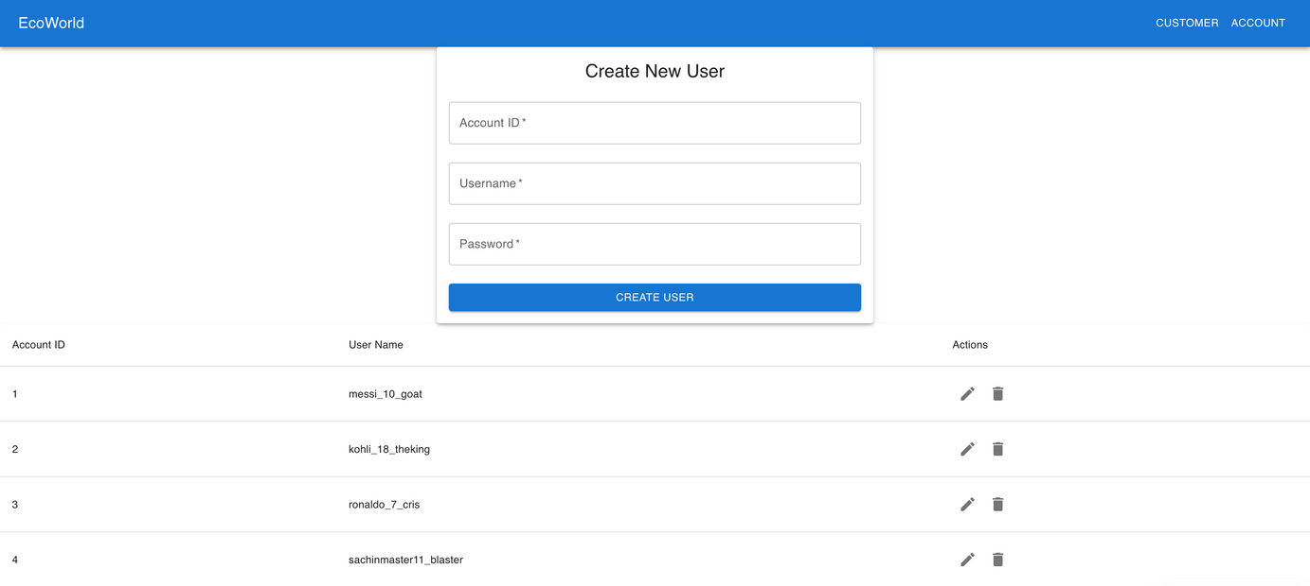
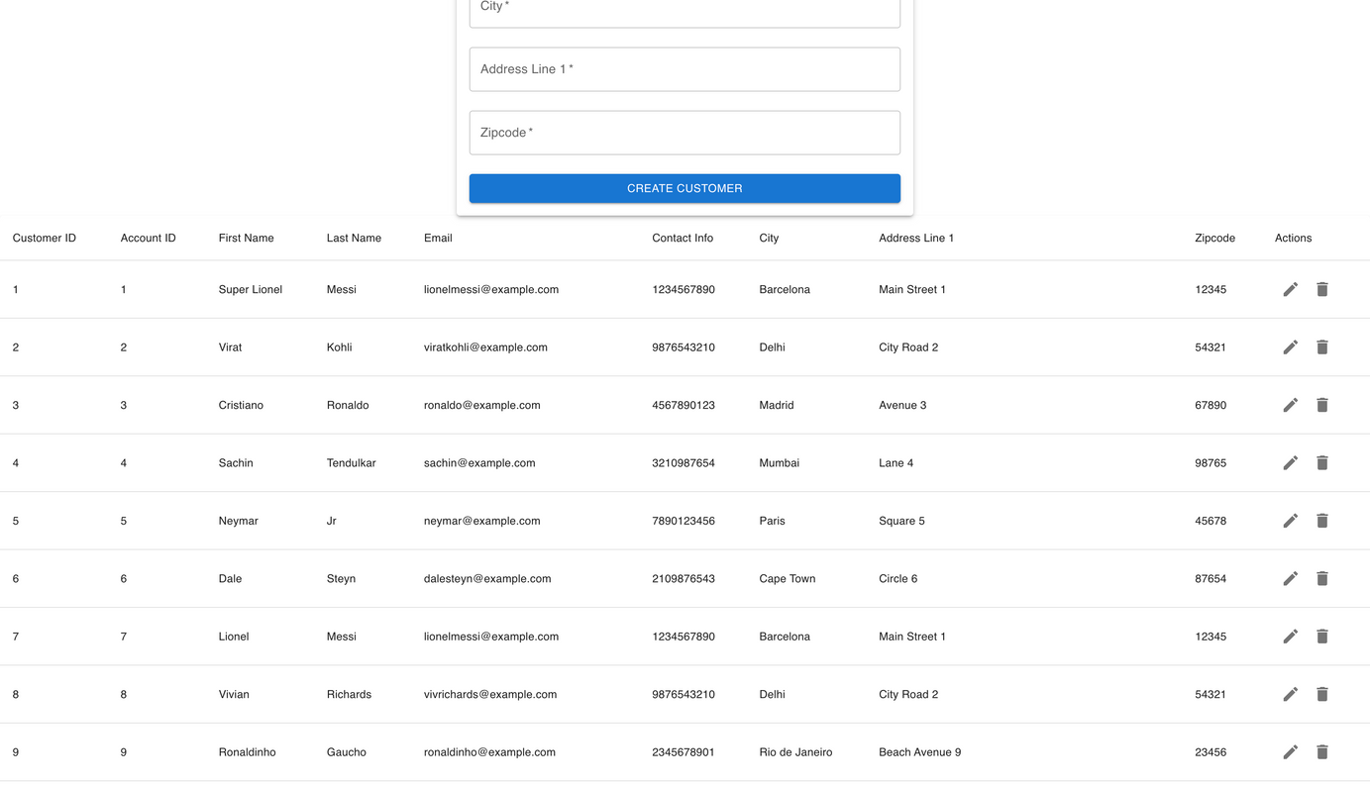
GRAPHICAL USER INTERFACE (GUI)
DAMG6210 - DATA MANAGEMENT AND DATABASE DESIGN

Slide 9
THANK YOU

